Slide 1
MLB Playoff Odds
AI Boot Camp Project 3
Team Members:
- Scott, Walter, and Kyle

Slide 2








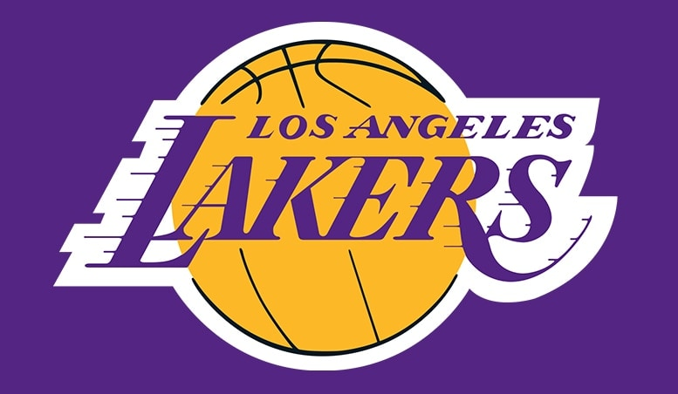

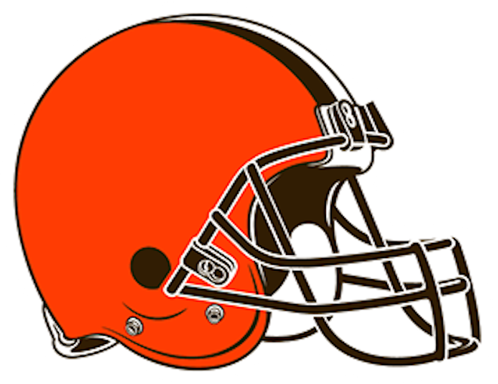

Our Favorite Sports Teams
Walter
Scott
Kyle

Slide 3

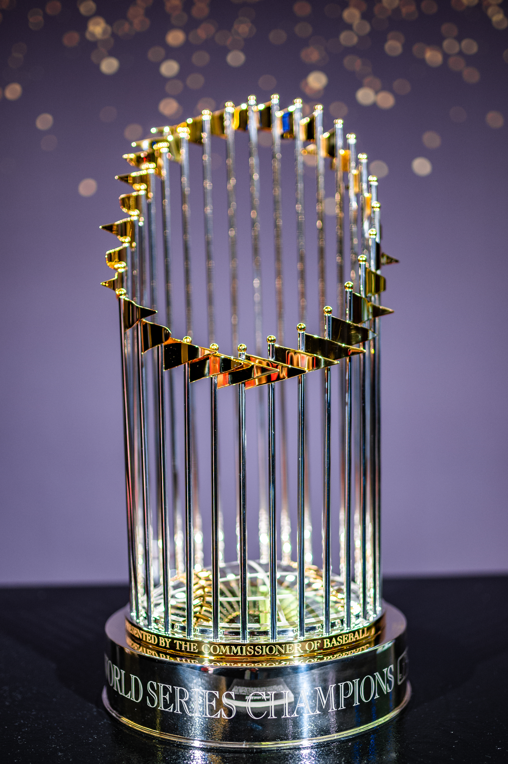
Project Overview
Project Purpose
Our goal was to leverage AI models with available statistics in order help predict a teams likelihood of making the MLB playoffs.

Slide 4
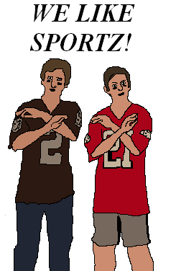
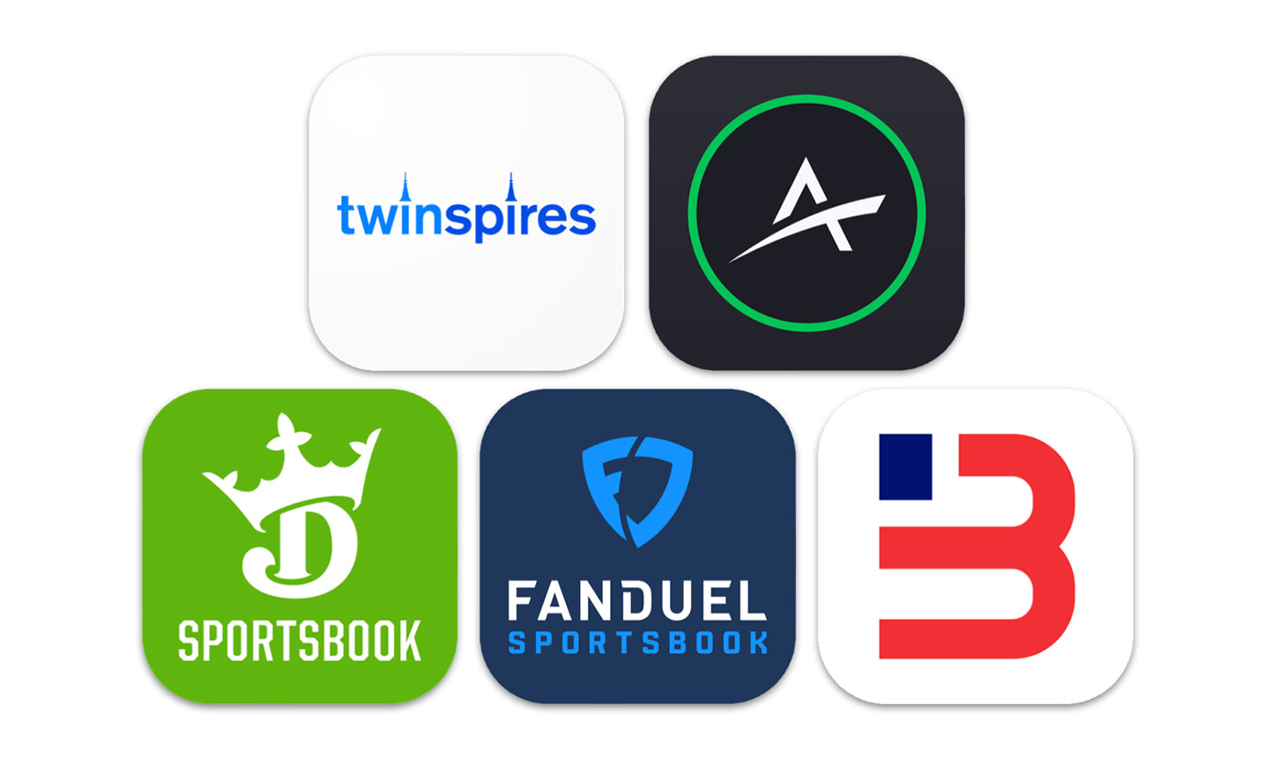
General: Sports and AI
According to Forbes, AI has the potential to impact some of the following:
AI for Predicting Player Performance and Injury Prevention
AI for Improving Sports Equipment
AI for Athlete Training
AI for Enhancing Fan Engagement
AI for Fairer Judging
Gambling
And fishing!

Slide 5
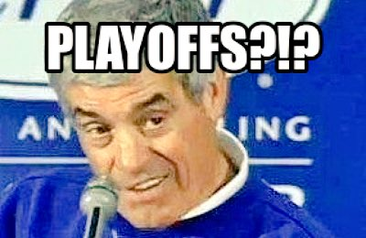
Project Overview
Goals/Problem to be solved
Can team statistics be leverage to determine the likelihood of making the playoffs?
Determine which statistics are most positively correlated with playoff success
Determine if a team is viewed in positive, negative, or neutral light

Slide 6
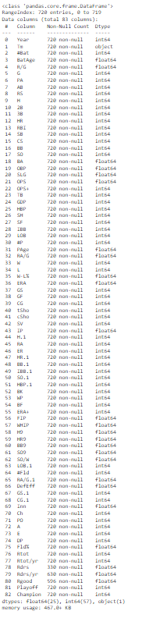
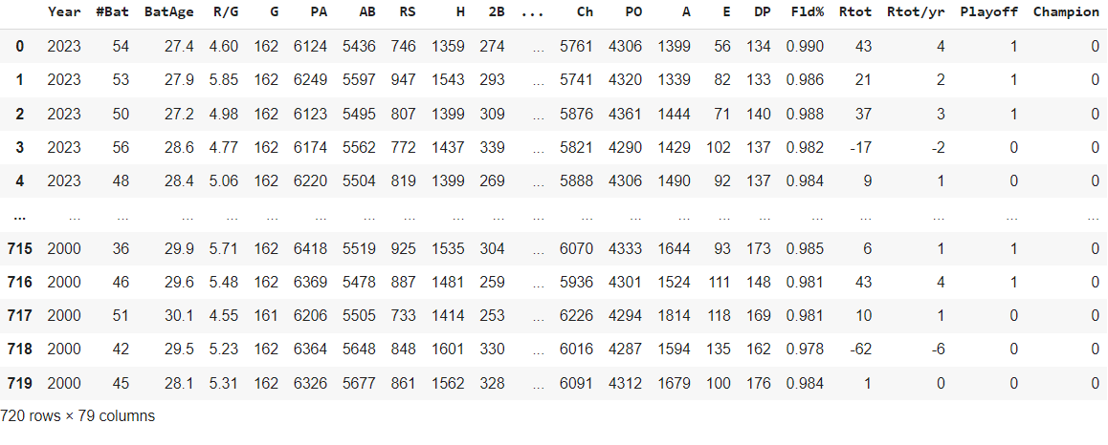
Overview of data collection, cleanup and exploration process
Leverage Baseball-Reference.com MLB Team stats for Batting, Pitching, and Fielding
Gathered data between 2000-2023 for all teams – 720 rows, over 80 features
Outside of team names, everything was numeric……no need to ENCODE ☺!!!
No null value rows dropped
Dropped Team column because not need, also dropped Rdrs/yr, Rgood and Rdrs (Fielding stats) because they were tracked through 2020
Added playoff and champion columns (0 or 1)

Slide 7

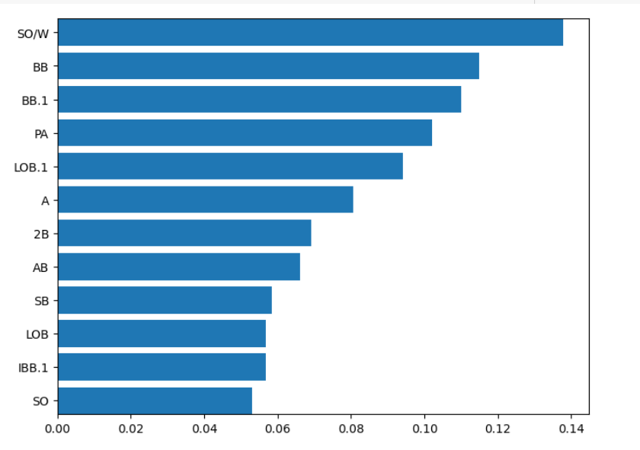
Approach taken to achieve goals
Exploring the data
Initial approach we compared average of entire data against average of teams that made playoffs and compare that with entire data standard deviation to see stats with most significant difference
Leveraged RandomForest and feature importance
Scaled data as well
Thinking about the game of baseball – a sound team is good at batting, pitching and fielding

Slide 8
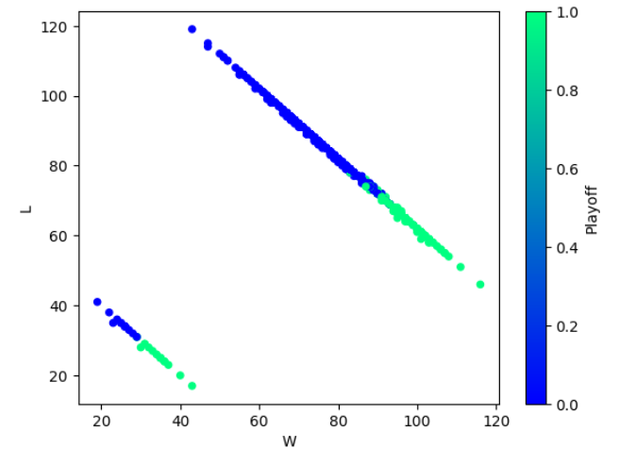
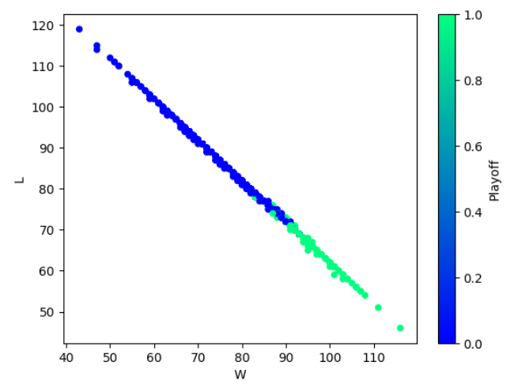
Exploring data further
Had to drop 2020 year….COVID

Slide 9
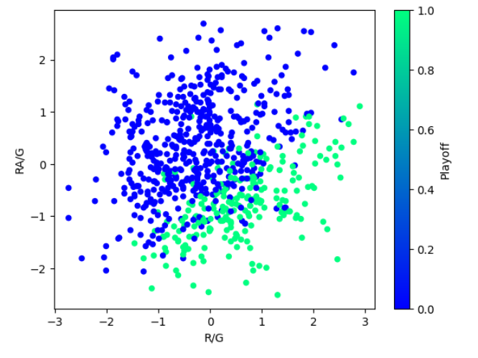
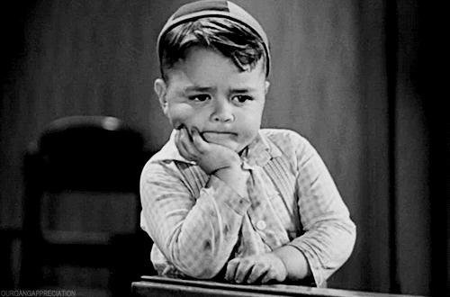
Good picture of potential inaccuracy causes….

Slide 10
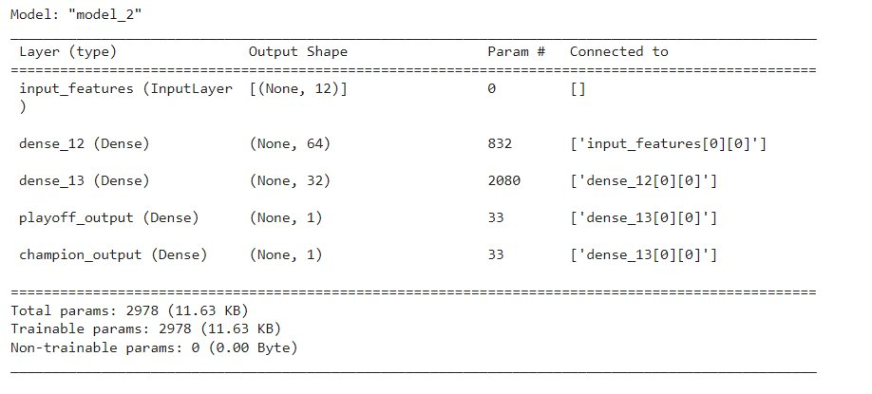
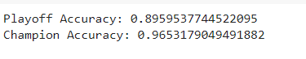
Branching Approach
Used sigmoid and relu for layers and binary_crossentropy

Slide 11
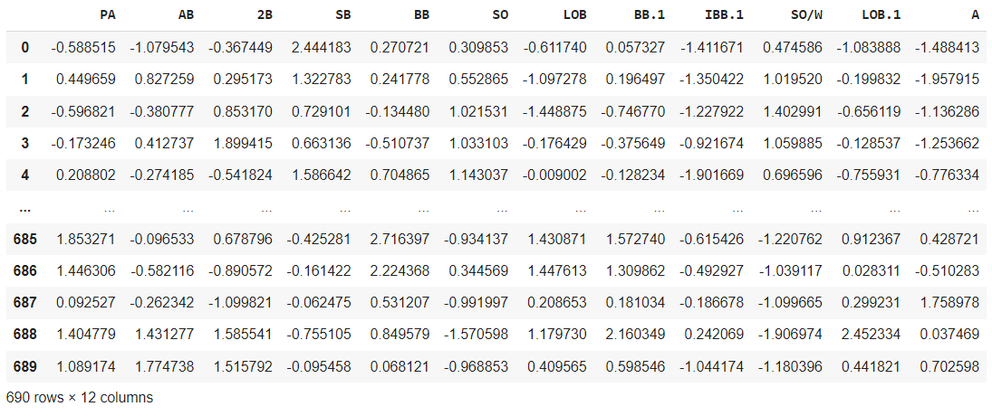
Used Columns
Notes:
Not using obvious columns

Slide 12
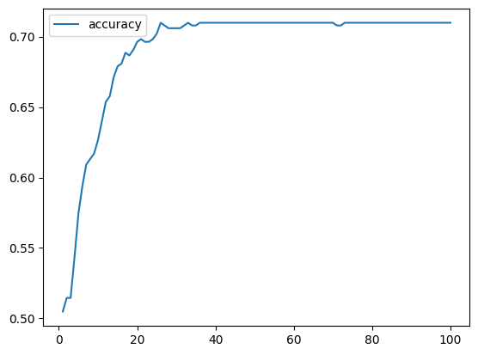
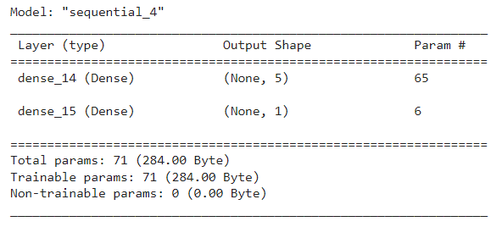
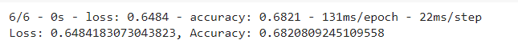
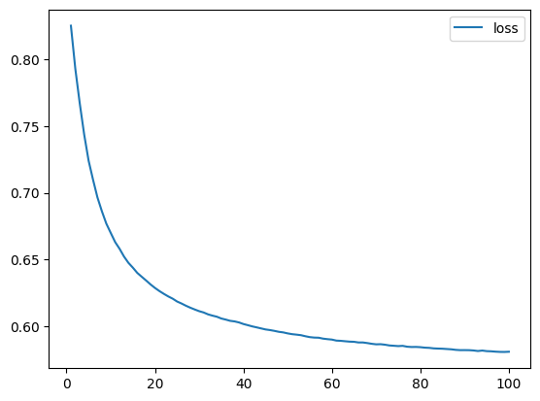
Neural Networks - Playoffs
Accuracy is decent, loss amount is interesting…what percent of teams do/don’t make playoffs?

Slide 13
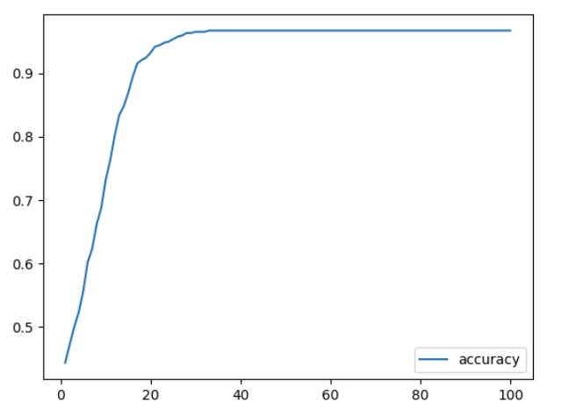
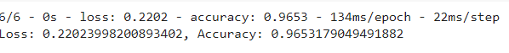
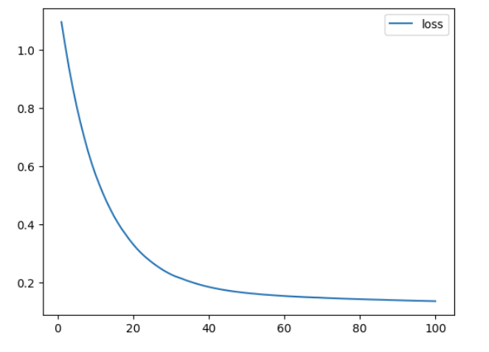
Neural Networks - Champion
Accuracy is very high (1 out of 30?). Potential for imbalance of data…not a lot of champion winners in out data set.

Slide 14
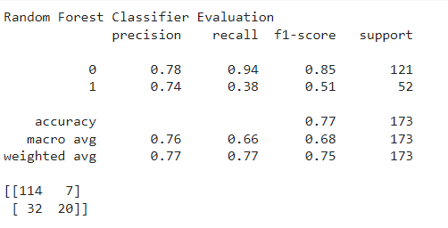
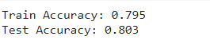
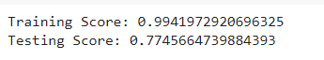
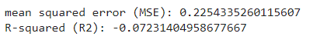
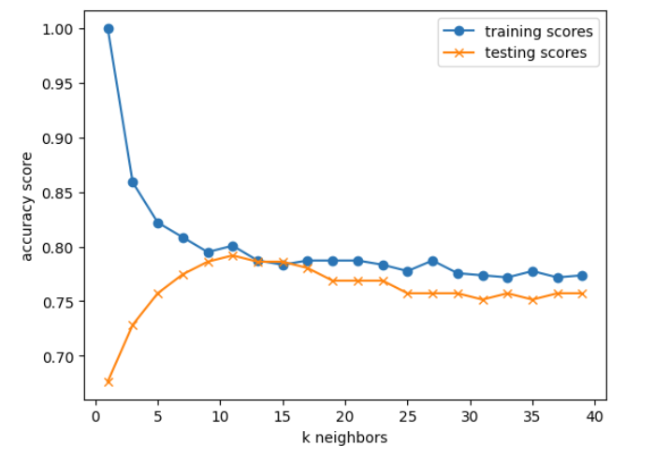
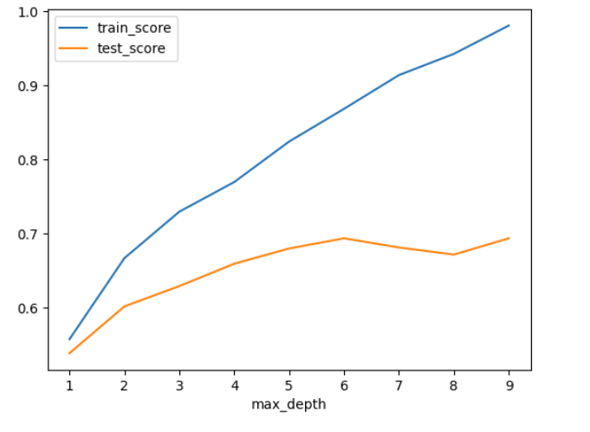
Other Models
SVC
Random Forest

Slide 15
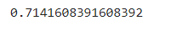
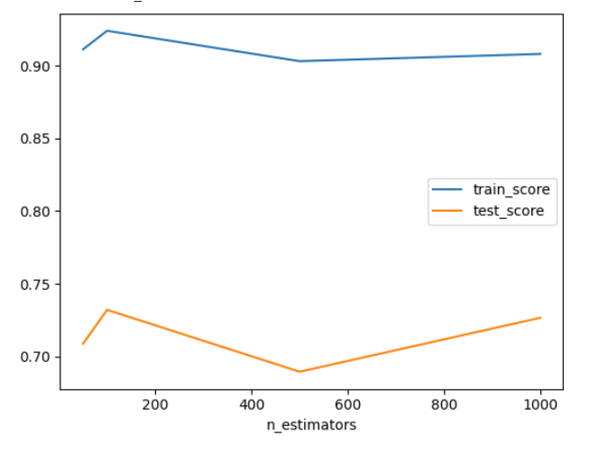
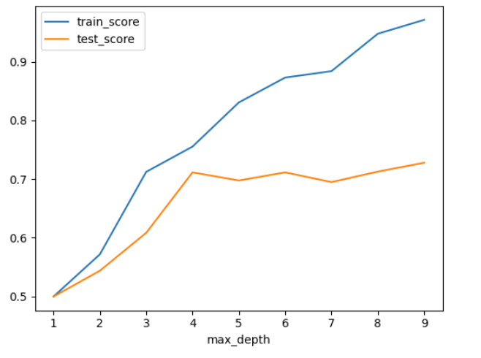
Other Models, con’t
PCA

Slide 16
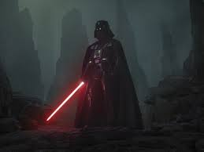
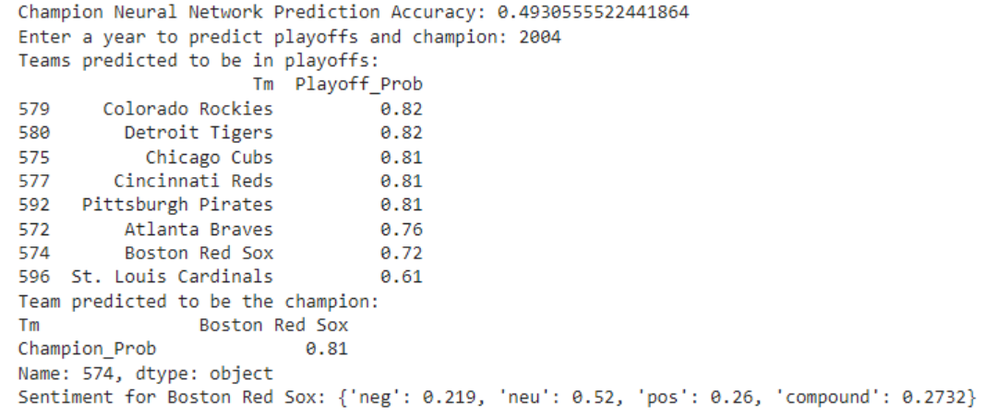
VADER – Sentiment Analysis Demo
Sentiment analysis on text to predict a champion (from thetoptens.com/baseball-favorite-major-league-team):
neg (negative): 0.219 - This indicates the proportion of negative sentiment in the text.
neu (neutral): 0.52 - This indicates the proportion of neutral sentiment in the text.
pos (positive): 0.26 - This indicates the proportion of positive sentiment in the text.
compound: 0.2732 - This is a normalized, weighted composite score of the sentiment that ranges from -1 (very negative) to +1 (very positive).
In this case, the sentiment analysis suggests that the text about the Boston Red Sox is mostly neutral with some positive and negative sentiments, and the overall sentiment is mildly positive (as indicated by the compound score of 0.2732).

Slide 17
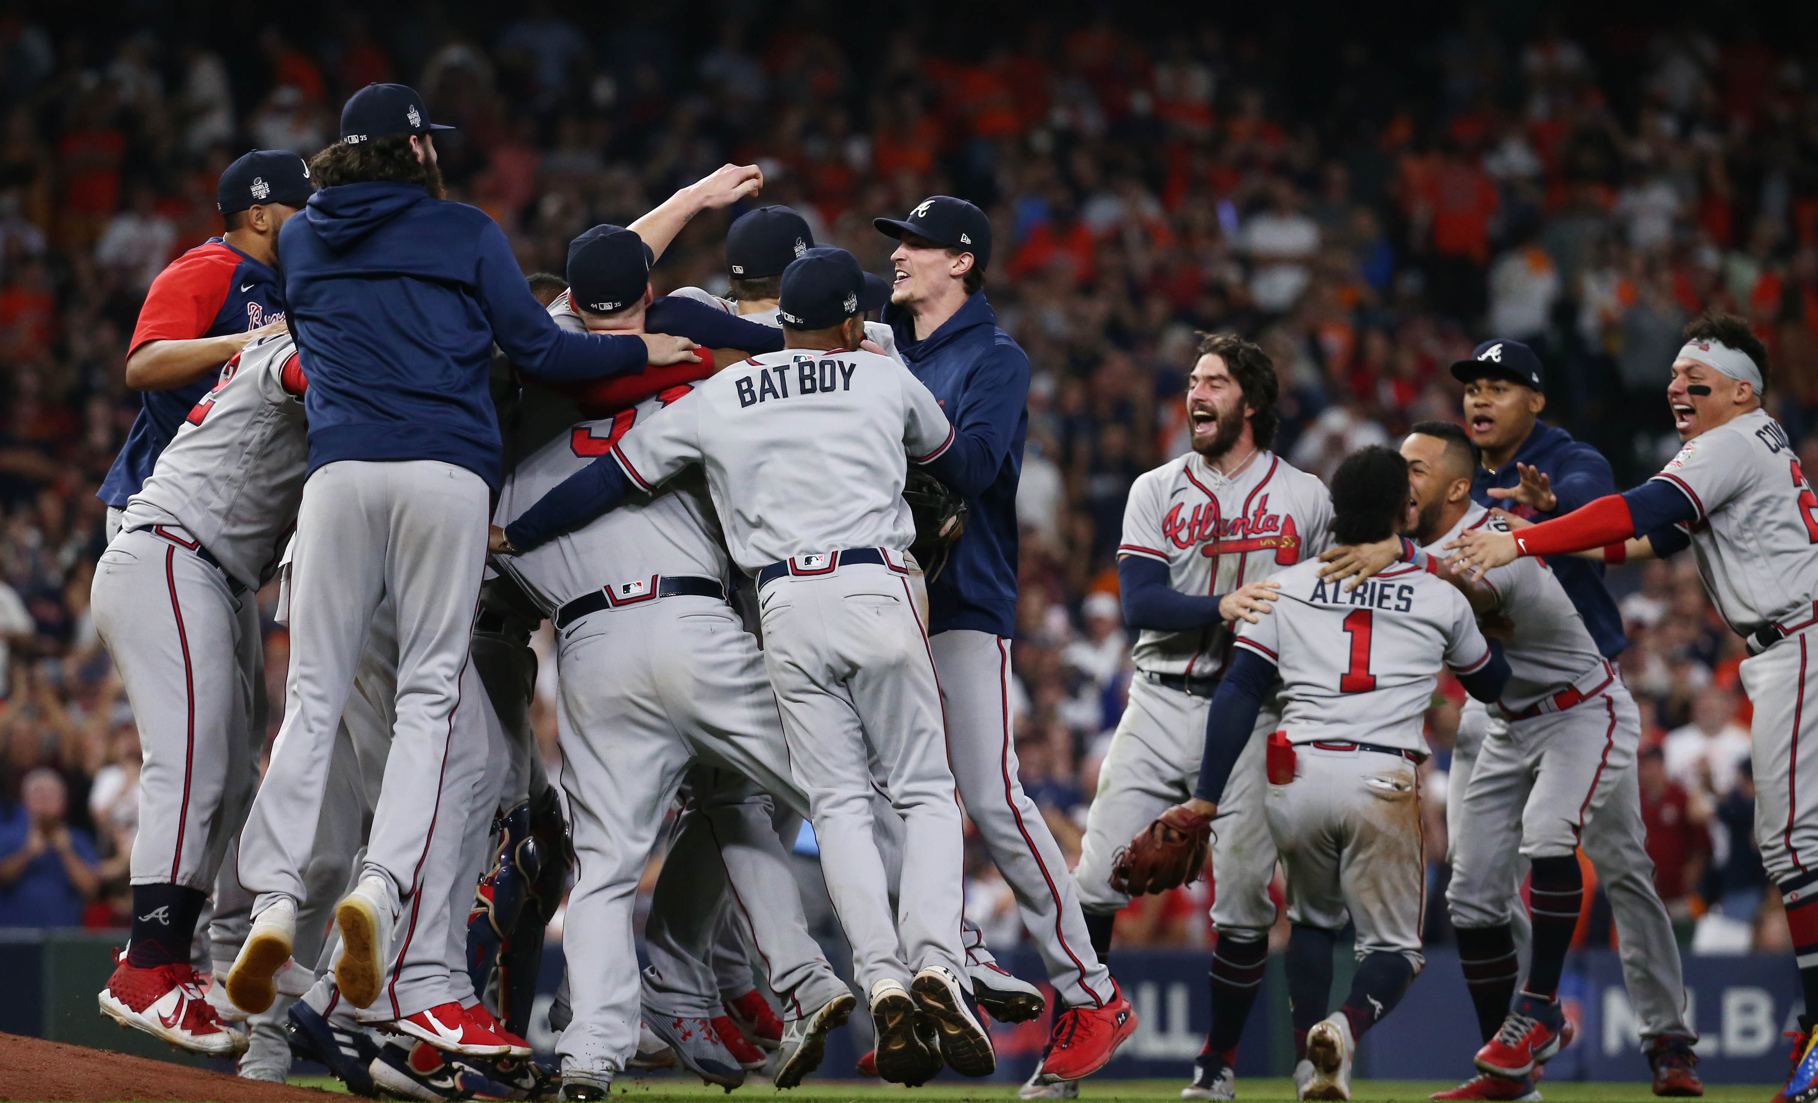

Overall, accuracy and performance of models was good – Branching had highest performance, Random Forest Testing was suspiciously high
We were able to determine that some statistics were more pertinent to predict potential playoff hopes
Successfully evaluated text to present a sentiment analysis
Summary

Slide 18
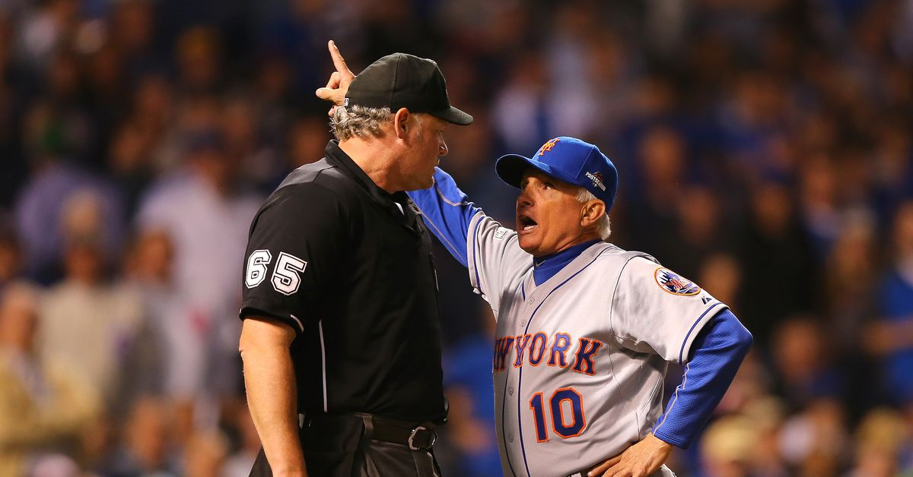
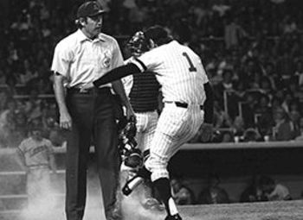
Overfitting
Imbalance on championship data
Decent amount of lost data, despite decent model performance
Could have gone further back in history to have a larger dataset
Available datasets for problems were not readily available
Sentiment analysis had some issues and was not leveraged in building the models
Problems Encountered

Slide 19

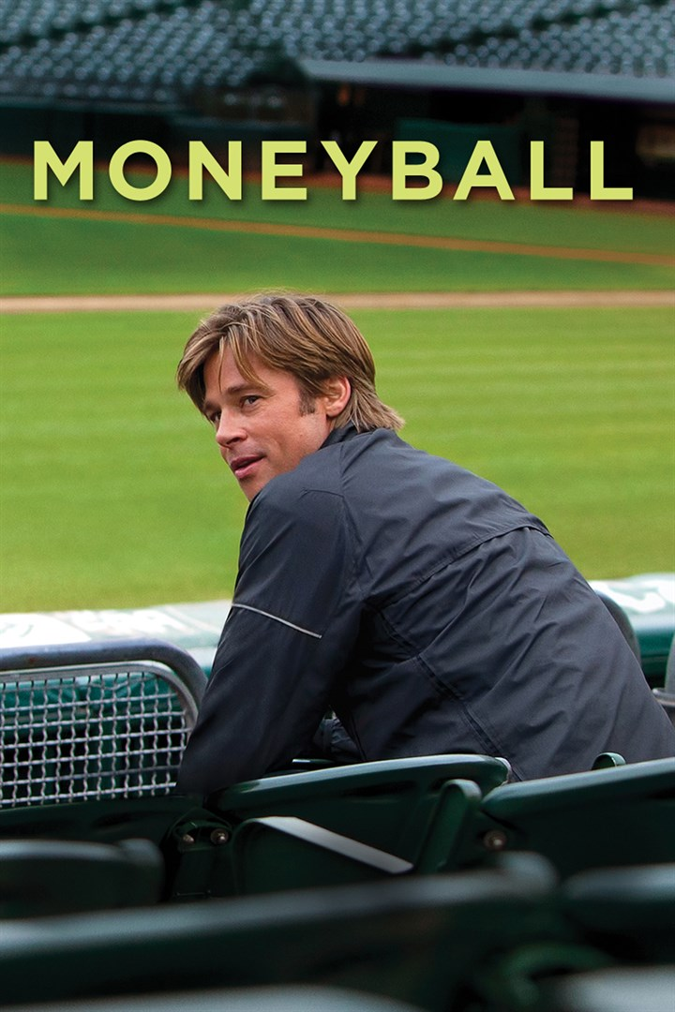
Leverage a lot more data – player data, injuries, weather
Use more features
Make dataset more balanced
Could apply to individual games – leverage sentiment analysis on articles before the game, weather, matchups, location
Analyze by division
Incorporate rules and rule changes that have happened over time
Movie Moneyball – think like a General Manager
Factoring in potential intangibles….like team personalities, player contracts
Team payrolls
Minor systems for each time
Sports psychology….
Future Considerations

Slide 20

THANK YOU!! What questions do you have?

